Slide 1
The Need for Academic Accommodation Post Concussion – A Faculty Discussion
Concussion Task Force

Slide 2
Definition
Concussion is a complex pathophysiological process affecting the brain, induced by traumatic biomechanical forces.
Common features include:
Rapid onset of usually short-lived neurological impairment which typically resolves spontaneously.
A range of clinical symptoms that may or may not involve loss of consciousness (LOC).

Slide 3
Definition
Acute clinical symptoms usually reflect a functional disturbance rather than structural injury.
Neuroimaging studies such as magnetic resonance imaging (MRI) and computerized tomography (CT) scans are typically normal and not performed as often as they once were.

Slide 4
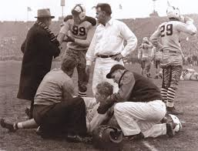
Concussions
Effects of concussion are cumulative in individuals who return to daily activity prior to complete recovery.

Slide 5
Concussion Facts
Up to 86% of concussed individuals will experience Post-Traumatic Migraine or some other type of headache pain.
Recent evidence indicates that presence and severity of headache symptoms may be a significant indicator of the severity of head injury and help guide return to normal daily activity.

Slide 6
Concussion Management
Serial Evaluations
Rest
Recommendations for limited cognitive activity after a head injury are now a standard in treating patients with concussions.

Slide 7
Concussion Treatment
Rest
Limited Physical Exertion
Limit Cognitive Exertion
Early intervention reduces prolonged recovery!
Concussion is perhaps the only injury that directly impacts the ability to learn.

Slide 8
Concussion Treatment: Key factors
Symptom exacerbated following physical or cognitive activity is a sign that the brain’s dysfunctional neurometabolism is being pushed beyond tolerable limits.
Modifications to physical and cognitive activities need to be in place:
Significant improved performance on post-concussion assessment and cognitive testing and ;
decreased symptom reporting following prescribed cognitive and physical rest (p < .001);
Regardless of the time between concussion and onset of rest. (Moser, Glatts & Schatz, May 2012.)

Slide 9
Cognitive rest means:
Time off from school or work
No homework
No reading
No visually stimulating activities, such as computers, video games, texting or use of cell phones, and limited or no television
No exercise, athletics, chores that result in perspiration/exertion
No trips, social visits in or out of the home; and
Increased rest and sleep.

Slide 10
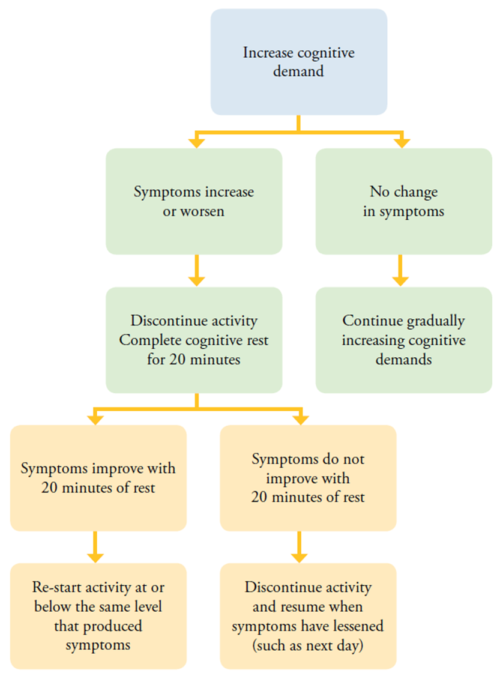
Cognitive Progression

Slide 11
Phase Concept – Phase 1 Rest
Symptoms Severity:
High level of symptoms that prevent them from going to class. Physical symptoms tend to interfere with even basic tasks.
Treatment:
Rest the brain and body as much as possible.
Intervention:
No Classes
No activities that exacerbate symptoms
Avoid “triggers” that worsen symptoms
No physical activity

Slide 12
Phase 2 – Partial Class with Accommodations
Symptoms Severity:
Symptoms have decreased to manageable level. Symptoms may be exacerbated by certain mental activities.
Treatment:
Balance rest with gradual re-introduction to class and work. Avoid symptom triggers.
Intervention:
Partial Attendance
Instructional modifications
Limited or partial class attendance
Rest breaks during class
Limited classwork/testing
Peer note taking
“Clear Desk”

Slide 13
Phase 3 – Full Class with Accommodations
Symptoms Severity:
Symptoms have decreased in both number and severity. Certain activities my still exacerbate symptoms.
Treatment:
Gradually increase demands on the brain by increasing the amount of work, length of time, and type or difficulty.
Intervention:
Prioritize assignments, test and projects.
Gradually increase amount of homework.
Symptoms addressed by specific accommodations
No physical activity.

Slide 14
Phase 4 – Full Class without Accommodations
Symptoms Severity:
Student may not have any symptoms or may have mild symptoms that are intermittent.
Treatment:
Accommodations are removed when student can function fully without them.
Intervention:
Construct a plan to finish completing missed academic work and keep stress levels low.
Returning to normal workload.

Slide 15
Phase 5 – Full Class
Symptom Severity:
No symptoms are present.
Treatment:
No accommodations are needed
Interventions
No instructional modifications

Slide 16
Instructional Modifications
No test (acute stage)
“Clear the desk” → Auditory only
Extra time for test
Extra time for assignments
No repetitious assignments
Water bottle at desk
Allow head down on desk
Periodic breaks within class
“Desktop only” → No Smart Board work
Turn lights off
Quite areas

Slide 17
Phased return is not for all
Some patients will return with no symptoms after just a few days off.
Will get right back into the flow of class, assignments and examination.

Slide 18
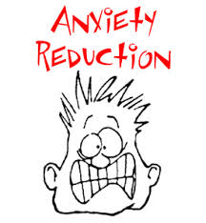
Social Emotional Balancing Act
Concussion are an energy crisis
Anxiety is an energy guzzler
Faculty play a key role in reducing time loss

Slide 19
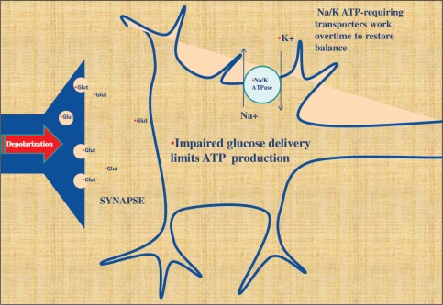
Symptoms of Post-Concussion Syndrome
Loss of intellectual capacity
Poor recent memory
Personality changes
Headache
Dizziness
Lack of concentration
Poor attention
Fatigue
Irritability
Phono/photophobia
Sleep disturbances
Depressed mood
Anxiety

Slide 20
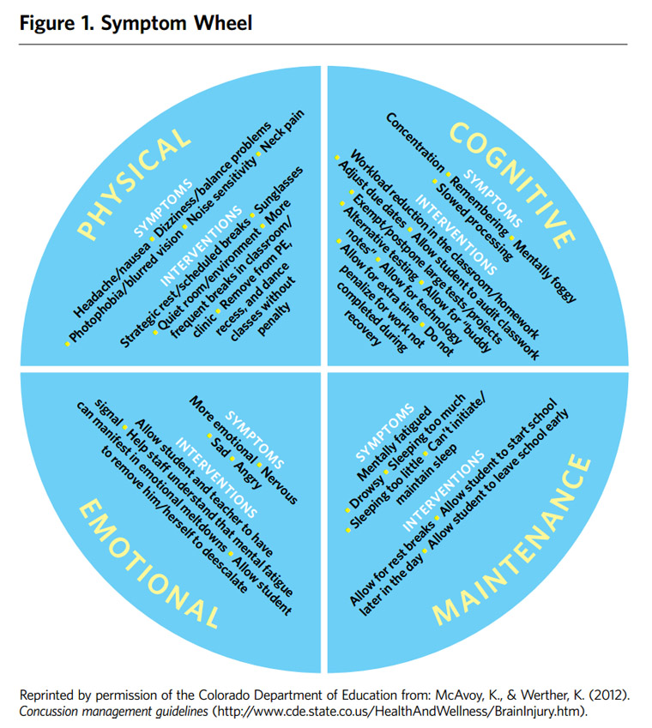

Slide 21
Dear Faculty Member,
This student is currently being evaluated for a concussion. Symptoms associated with the type of injury may include, but are not limited to; headache, dizziness, difficulty concentrating, fatigue, fogginess, sensitivity to light & noise, changes in social or academic interaction and difficulty reading. Symptoms may become pronounced later in the day and may return with higher level thinking tasks and cognitive exertion. Please let us know if you notice any changes in this student’s academic or social behavior in your class, as this will assist us in the follow-up care they receive.

Slide 22
Closing Comments
Provide time for recovery and reasonable modifications.
You are part of the teamed approach to returning this student back to optimal health.

Slide 23
RETURN TO LEARN
STUDENT PRESENTS WITH SYMPTOMS OF CONCUSSION
ATHLETIC TRAINING HEALTH SERVICES
Normal 1-2 Week Recovery
Prolonged Recovery Greater than 2 weeks
HEALTH SERVICES
Normal 1-2 Week Recovery
Dean of Student’s Office sends out notification to Faculty
Referred to Learning Support Services for Accommodation Assessment
Prolonged Recovery > 2 weeks
Notification sent to Faculty

Slide 24
References
Return to Learning: Going Back to School Following a Concussion, McAvory, K, Research Based Practice. 2012
Guskiewicz, KM, Bruce, SL., Cantu, RC., Ferrara, MS., Kelly, JP., McCrea, M., Putukian, M., McLeod, TCV. (2004). National Athletic Trainers Association Position Statement: Management of sport-related concussion. Journal of Athletic Training, 39(3), 280-297.
Guilmette, T., et. al. (2007). Concussion understanding and management among New England high school football coaches. Brain Injury, 21(10): 1039-1047.
Cantu, R. C. (1998). Second impact syndrome. Clinical Sports MedicineI, 17(1), 37–44.
Giza, C. C., & Hovda, D. A. (2001). The neurometabolic cascade of concussion. Journal of Athletic Training, 36(3), 228–235.

Slide 25
References
Langlois, J. A., Rutland-Brown, W., & Wald, M. M. (2006). The epidemiology and impact of traumatic brain injury: A brief overview. Journal of Head Trauma and Rehabilitation, 21(5), 375–378.
Majerske, C. W., Mikalik, J .P., Ren, D., Collins, M. W., Cmiolo Reddy, C., Lovell, M. R., & Wagner, A. K. (2008). Concussion in sports: Postconcussive activity levels, symptoms, and neurocognitive performance. Journal of Athletic Training, 43(3), 265–274.
McCrory, P., Meeuwisse, W., Johnston, K., Dvorak, J., Aubry, M., Molloy, M., & Cantu, R. (2009). Consensus statement on concussion in sport: The 3rd international conference on concussion held in Zurich, November 2008. Journal of Athletic Training, 44(4), 434–448.

Slide 26
References
McCrory, P, Meeuwisse, W., Johnton, K, Dvorak, J., Aubry, M., Molloy, M and Cantu, R. (2009). Consensus Statement of Concussion in Sport 3rd International Conference on Concussion in Sport. Clinical Journal of Sports Medicine 19(3), 185-195.
Notebaert, A, & Guskiewicz, K. (2005). Current Trends in Athletic Training Practice for Concussion Assessment and Management. Journal of Athletic Training, 40(4): 320-325.
ImPACT Training; Connecting the dots between clinical assessment and academic accommodations.

